Slide 1
Digital Electronics
Dr. Pham Ngoc Nam

Slide 2
Acknowledgement
The main part of the slides was adopted and modified from the original slides of Prof. Rudy Lauwereins, Vice president of IMEC, Leuven, Belgium with his permission.
1/<number>

Slide 3
Your instructor
Bộ môn kỹ thuật điện tử tin học
  Office: C9-401
  Email: pnnam-fet@mail.hut.edu.vn
Research:
  FPGA, PSoC, hệ nhúng
  Trí tuệ nhân tạo
Education:
  K37 điện tử-ĐHBK Hà nội (1997)
  Master về trí tuệ nhân tạo 1999, Đại học K.U. Leuven, vương quốc Bỉ
    Đề tài: Nhận dạng chữ viết tay
  Tiến sỹ kỹ thuật chuyên ngành điện tử-tin học, 9/ 2004, Đại học K.U. Leuven-IMEC, Vương Quốc Bỉ
    Đề tài: quản lý chất lượng dịch vụ trong các ứng dụng đa phương tiện tiên tiến

Slide 4
Course contents
Digital design
Combinatorial circuits: without status
Sequential circuits: with status
FSMD design: hardwired processors
Language based HW design: VHDL
1/<number>

Slide 5
Course contents
Digital design
Combinatorial circuits: without status
Sequential circuits: with status
FSMD design: hardwired processors
Language based HW design: VHDL
1/<number>

Slide 6
Contents of “Digital Design”
Introduction to the course
Data representation
Boolean algebra
Logical gates
1/<number>

Slide 7
Contents of “Digital Design”
Introduction to the course
  Course book
  Goal
  Exercises and laboratory sessions
  Exam
Data representation
Boolean algebra
Logical gates
1/<number>

Slide 8
Contents of “Digital Design”
Introduction to the course
  Course book
  Goal
  Exercises and laboratory sessions
  Exam
Data representation
Boolean algebra
Logical gates
1/<number>

Slide 9
Course books
Mandatory:
  “Principles of Digital Design”, Daniel D. Gajski, Prentice Hall, 1997, ISBN 0-13-301144-5
References:
  Douglas L. Perry, VHDL: Programming by Examples, McGraw-Hill, fourth Edition, 2002.
  “Logic and Computer Design Fundamentals”, M. Morris Mano & Charles R. Kime, Prentice Hall, 2nd edition, 2000, ISBN 0-13-016176-4
  TS. Nguyễn Nam Quân : “Toán logic và Kỹ thuật số”, Nhà xuất bản khoa học và kỹ thuật, 2006
1/<number>

Slide 10
Contents of “Digital Design”
Introduction to the course
  Course book
  Goal
  Exercises and laboratory sessions
  Exam
Data representation
Boolean algebra
Logical gates
1/<number>

Slide 11
Goal of the course
Give insight in the design of digital electronic systems at the gate and register-transfer level
Teach the use of modern design tools
Offer all building blocks needed to construct complex digital circuits, including processors
Present the difference between functional requirements (operation) and non-functional requirements (cost, speed, power, area)
Introduce modern implementation platforms: PLA, PLD, FPGA
1/<number>

Slide 12
Contents of “Digital Design”
Introduction to the course
  Course book
  Goal
  Exercises and laboratory sessions
  Exam
Data representation
Boolean algebra
Logical gates
1/<number>

Slide 13
Exercises and laboratory sessions
Bài 1: Các phần tử logic cơ bản – Bộ chọn dữ liệu phân kênh
Bài 2: Các Trigơ RS, D, JK – Bộ đếm LED 7 thanh
Bài 3: Làm quen với phần mềm thí nghiệm thông qua một ví dụ thiết kế đơn giản
Bài 4: Thiết kế bộ so sánh hai số 3 bit: Bài thí nghiệm này giúp sinh viên luyện tập tối thiểu hóa bìa Karnaugh 6 biến và biết cách thiết kế mạch logic tổ hợp từ các phần tử logic cơ bản
Bài 5: Thiết kế bộ phát hiện tổ hợp bit trong một chuỗi bit: Giúp sinh viên biết cách xây dựng máy trạng thái và thiết kế hệ thông số bằng máy trạng thái
Bài 6: Thực hiện thuật toán FIR dùng cấu trúc FSMD
1/<number>

Slide 14
Contents of “Digital Design”
Introduction to the course
  Course book
  Goal
  Exercises and laboratory sessions
  Exam
Data representation
Boolean algebra
Logical gates
1/<number>

Slide 15
Exam
Close book
Midterm exam: 30%
Final exam: 70%
Completing lab sessions is a must before taking the exam
1/<number>

Slide 16
Contents of “Digital Design”
Introduction to the course
Data representation
  Decimal, Binary, Octal, Hexadecimal
  Addition, subtraction, multiplication, division
  Negative numbers
  Integer, fixed point, fractional, floating point, BCD, ASCII
Boolean algebra
Logical gates
1/<number>

Slide 17
Contents of “Digital Design”
Introduction to the course
Data representation
  Decimal, Binary, Octal, Hexadecimal
  Addition, subtraction, multiplication, division
  Negative numbers
  Integer, fixed point, fractional, floating point, BCD, ASCII
Boolean algebra
Logical gates
1/<number>

Slide 18
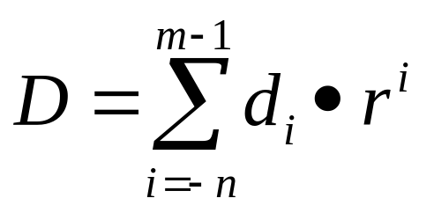
Decimal
1234.567₁₀=
  1•1000+2•100+3•10+4•1+5•0.1+6•0.01+7•0.001
  1•10³+2•10²+3•10¹+4•10⁰+5•10⁻¹+6•10⁻²+7•10⁻³
  r = radix (r = 10), d=digit (0 ≤ d ≤ 9), m = #digits before radix point (decimal point), n = #digits after decimal point
1/<number>

Slide 19
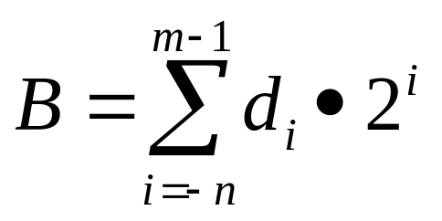
Binary
1011.011₂=
  1•8+0•4+1•2+1•1+0•0.5+1•0.25+1•0.125
  1•2³+0•2²+1•2¹+1•2⁰+0•2⁻¹+1•2⁻²+1•2⁻³
  r = radix (r = 2), d = digit (0 ≤ d ≤ 1), m = #digits before radix point (binary point), n = #digits after radix point
1/<number>

Slide 20
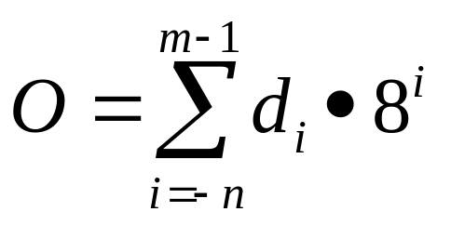
Octal
7654.32₈=
  7•512+6•64+5•8+4•1+3•0.125+2•0.015625
  7•8³+6•8²+5•8¹+4•8⁰+3•8⁻¹+2•8⁻²
  r = radix (r = 8), d = digit (0 ≤ d ≤ 7), m = #digits before radix point (octal point), n = #digits after radix point
1/<number>

Slide 21
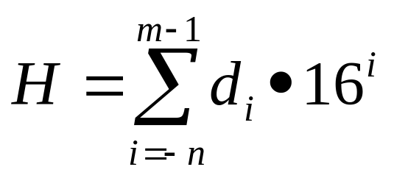
Hexadecimal
FEDC.76₁₆=
  15•4096+14•256+13•16+12•1+7•1/16+6•1/256
  15•16³+14•16²+13•16¹+12•16⁰+7•16⁻¹+6•16⁻²
  r = radix (r = 16), d = digit (0 ≤ d ≤ F), m = #digits before radix point (hexadecimal point), n = #digits after radix point
1/<number>

Slide 22
Contents of “Digital Design”
Introduction to the course
Data representation
  Decimal, Binary, Octal, Hexadecimal
  Addition, subtraction, multiplication, division
  Negative numbers
  Integer, fixed point, fractional, floating point, BCD, ASCII
Boolean algebra
Logical gates
1/<number>

Slide 23
Binary addition
Decimal addition
carry
0
1
0
x
8
2
7
3
y
5
6
2
sum
8
8
3
5
Binary addition
carry
0
0
1
1
1
1
1
x
1
0
0
1
1
0
1
1
y
1
0
1
0
1
1
1
sum
1
1
1
1
0
0
1
0
1/<number>

Slide 24
Binary subtraction
x
1 1 1 0 1
y
1 1 1 1
borrow
1 1 1 0
result
0 1 1 1 0
1/<number>

Slide 25
Binary multiplication
1 1 1 0
1 1 0 1
1 1 1 0
0 0 0 0
1 1 1 0
1 1 1 0
1 0 1 1 0 1 1 0
Multiplication by repeated add & shift: number of cycles = number of bits of multiplier
Can be implemented in a faster way
1/<number>

Slide 26
Binary division
1 0 1 1 1 0 1 0
1 1 1 0
1 1 1 0
1 1 0 1
1 0 0 1 0 1 0
1 1 1 0
1 0 0 1 0
0 0 0 0
1 0 0 1 0
1 1 1 0
1 0 0
Division by repeated subtract & shift: number of cycles = number of bits of result
Mostly done this way
1/<number>

Slide 27
Contents of “Digital Design”
Introduction to the course
Data representation
  Decimal, Binary, Octal, Hexadecimal
  Addition, subtraction, multiplication, division
  Negative numbers
  Integer, fixed point, fractional, floating point, BCD, ASCII
Boolean algebra
Logical gates
1/<number>

Slide 28
Sign-Magnitude representation
Each number consists of two parts : sign and magnitude
Decimal example: +123₁₀ (by convention also ‘123’) and -123₁₀
Binary: sign represented by MSB; ‘0’ = positive, ‘1’ = negative
Binary example: 01100₂ = +12₁₀ en 11100₂ = -12₁₀
A sign-magnitude integer with n bits lies between -(2^{n-1}-1) and +(2^{n-1}-1) with two representations for 0: 000...0 en 100...0
Generic representation of a sign-magnitude integer: B = <s,m>
1/<number>

Slide 29
Sign-Magnitude addition and subtraction
Start
subtraction
Start
addition
s₂=s’₂
no
s₁=s₂
yes
no
m1>m2
yes
no
m₁<m₂
yes
m_{r}=0
s_{r}=0
m_{r}=m₂-m₁
s_{r}=s₂
m_{r}=m₁-m₂
s_{r}=s₁
m_{r}=m₁+m₂
s_{r}=s₁
End
1/<number>

Slide 30
Sign-Magnitude addition and subtraction
Multiplication and division are repeated add/subtract & shift and can hence be carried out with such an adder/subtractor
Sign-magnitude representation leads to slow, expensive adder/subtractor due to repeated comparison and test of sign and magnitude
This is why we represent numbers mostly using two’s complement notation
1/<number>

Slide 31
Two’s complement notation
Radix-complement of a number D with m digits is D* = r^{m} - D
eg. The 10-complement of 123₁₀ is
10³ - 123₁₀ = 877₁₀
eg. The 2-complement of 1101₂ is
2⁴ - 13₁₀ = 3₁₀ = 0011₂
Call D’ the digit complement, then D*=D’+1 (proof in book); this offers us an easier way of determining the two’s complement:
eg. The 2-complement of 1101₂ is
0010₂ + 0001₂ = 0011₂
1/<number>

Slide 32
Two’s complement notation
How do we negate a number D, i.o.w. how do we obtain -D?
D* = r^{m} - D ⇒ D* + D = r^{m} = 0 when we retain only the m least significant digits ⇒
D* = -D
eg. D=0011₂ ⇒ D*=1100₂+0001₂=1101₂
D+D*=0011₂+1101₂=10000₂=2⁴=0 when we retain only the m least significant bits; we may hence use D*=1101₂ for the binary representation of -D=-3₁₀
What is the negation of D=0000₂? D*=1111₂+0001₂=10000₂=0000₂
There is only 1 notation for ‘zero’
A 2-complement integer with n bits lies between -(2^{n-1}) and +(2^{n-1}-1)
1/<number>

Slide 33
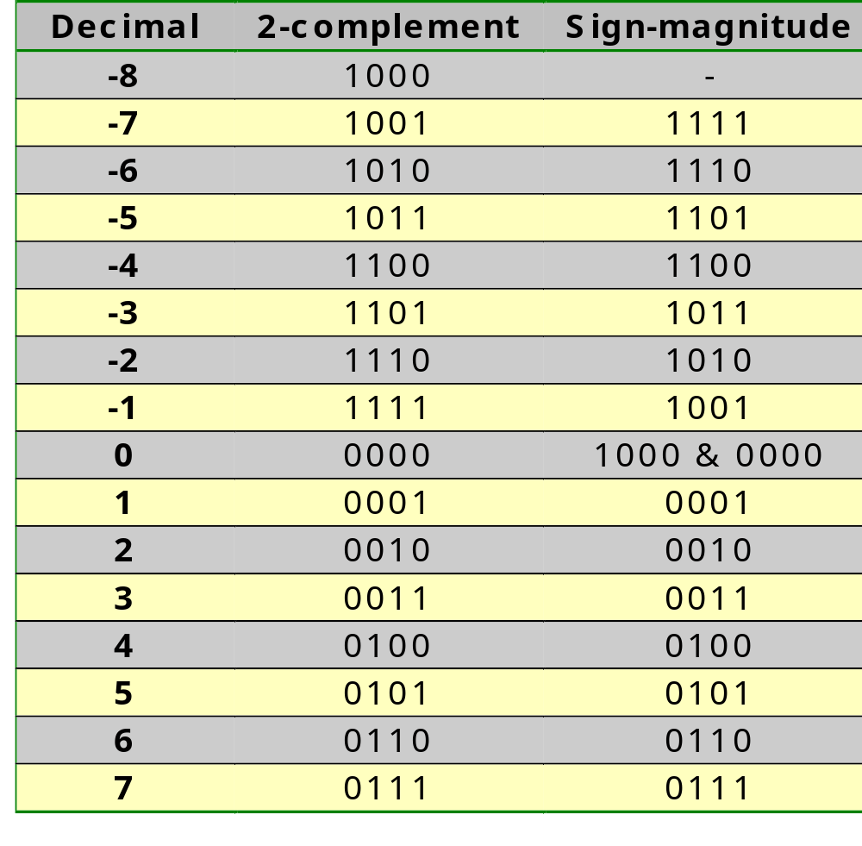
Two’s complement notation
Negating a 2-complement number requires many more
bit-flips than negating a sign-magnitude number:
sign-magnitude is less power hungry than 2-complement
1/<number>

Slide 34
Two’s complement addition and subtraction
Start
subtraction
Start
addition
B₂=B’₂+1
B_{r}=B₁+B₂
End
The negation needed for the subtraction is done by taking the bit-complement of B₂; the addition of the ‘1’ is done by putting the LSB carry-in of the next addition to 1.
1/<number>

Slide 35
Two’s complement addition and subtraction
Addition
0010 +2
0010 +2
1110 - 2
0100 +4
1100 - 4
1100 - 4
+
00000
+
00000
+
11000
0110 +6
1110 - 2
1010 - 6
Subtraction
0010 +2
0010 +2
1110 - 2
1011 (+4)’
0011 (- 4)’
0011 (- 4)’
+
00111
+
00111
+
11111
1110 - 2
0110 +6
0010 +2
Overflow
0111 +7
1001 - 7
0110 +6
1010 - 6
+
01100
+
10000
1101 - 3
0011 +3
1/<number>

Slide 36
Contents of “Digital Design”
Introduction to the course
Data representation
  Decimal, Binary, Octal, Hexadecimal
  Addition, subtraction, multiplication, division
  Negative numbers
  Integer, fixed point, fractional, floating point, BCD, ASCII
Boolean algebra
Logical gates
1/<number>

Slide 37
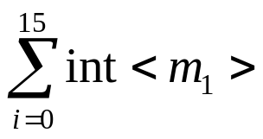
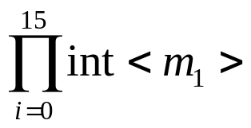
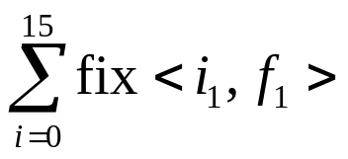
Integer, fixed point, fractional, floating point
Integer
  int<m>: 101011. ⇒ m=6
  int<m₁>+int<m₂> = int<m> and m≤max(m₁,m₂)+1
  int<m₁>•int<m₂> = int<m> and m=m₁+m₂
How many bits are needed for
?
m≤m₁+log₂16
How many bits are needed for
?
m=16•m₁
Fixed point
  fix<i,f>: 1101.010 ⇒ i = 4, f = 3
  fix<i₁,f₁>+fix<i₂,f₂> = fix<i,f> and i≤max(i₁,i₂)+1 & f≤max(f₁,f₂)
  fix(i₁,f₁)•fix(i₂,f₂) = fix<i,f> and i=i₁+i₂ & f=f₁+f₂
How many bits are needed for:
?
i≤i₁+log₂16 &
f=f₁
1/<number>

Slide 38
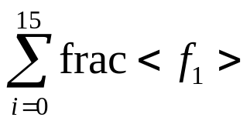
Integer, fixed point, fractional, floating point
Fractional
  frac<f>: 0.01101 ⇒ f = 5
  frac<f₁>+frac<f₂> = fix<1,f> and f≤max(f₁,f₂)
  frac<f₁>•frac<f₂> = frac<f> and f=f₁+f₂
How many bits are needed for
?
i≤log₂16 &
f=f₁
Floating point
  float<m,e>: 0.11010•2^101 ⇒ m = 5, e = 3
1/<number>

Slide 39
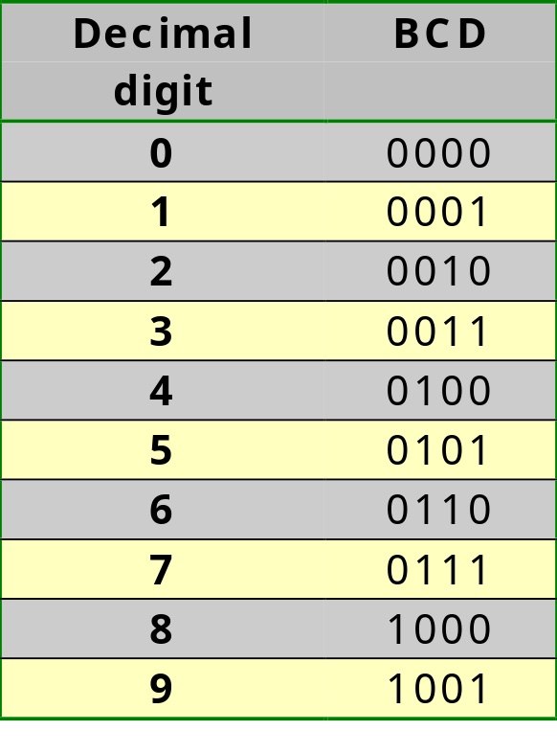
BCD
Binary Coded Decimal number
1/<number>

Slide 40
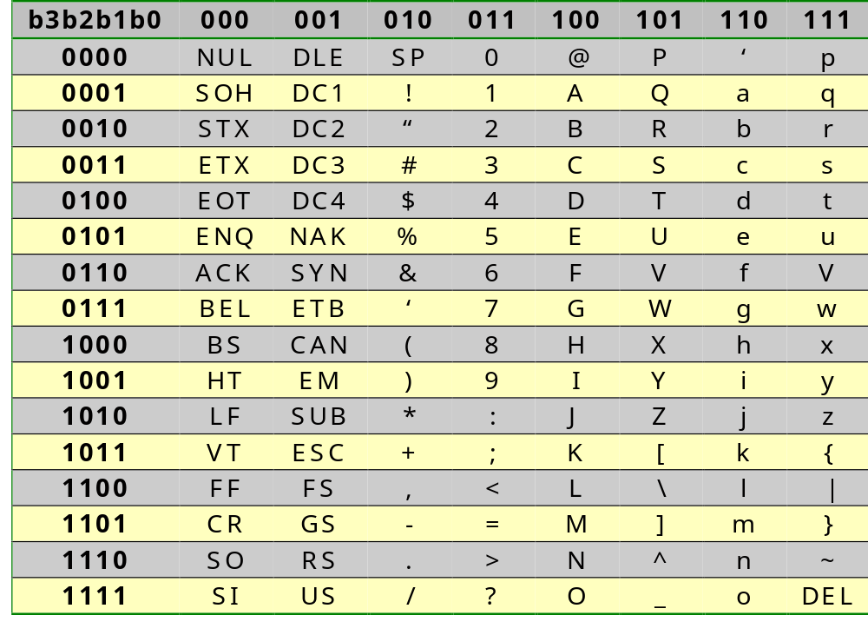
ASCII
American Standard Code for Information Interchange (7-bit code)
1/<number>

Slide 41
Contents of “Digital Design”
Introduction to the course
Data representation
Boolean algebra
  Axiomatic definition of Boolean algebra
  Theorems of Boolean algebra
  Boolean functions
  Canonical form
  Standard form
  The 16 functions of 2 variables
Logical gates
1/<number>

Slide 42
Contents of “Digital Design”
Introduction to the course
Data representation
Boolean algebra
  Axiomatic definition of Boolean algebra
  Theorems of Boolean algebra
  Boolean functions
  Canonical form
  Standard form
  The 16 functions of 2 variables
Logical gates
1/<number>

Slide 43
Axiomatic definition of Boolean algebra
A1 (Closure):
  B is closed w.r.t. + (OR)
  B is closed w.r.t. • (AND)
A2 (Identity element)
  B has an identity element w.r.t. +, designated by 0
  B has an identity element w.r.t. •, designated by 1
A3 (Commutativity)
  B is commutative w.r.t. +, i.o.w. x+y=y+x
  B is commutative w.r.t. •, i.o.w. x•y=y•x
1/<number>

Slide 44
Axiomatic definition of Boolean algebra
A4 (Distributivity)
  • is distributive w.r.t. +, i.o.w. x•(y+z)=(x•y)+(x•z)
  + is distributive w.r.t. •, i.o.w. x+(y•z)=(x+y)•(x+z)
A5 (Complement element -- NOT operator)
  ∀x∈B, ∃x’∈B: x+x’=1
  ∀x∈B, ∃x’∈B: x•x’=0
A6 (Cardinality bound)
  There exist at least two different elements in B
1/<number>

Slide 45
Axiomatic definition of Boolean algebra
Differences w.r.t. ordinary algebra
  In ordinary algebra + is not distributive w.r.t. •:
  5+(2•4) ≠ (5+2) • (5+4)
  In boolean algebra, an inverse operation for the addition (OR) does not exist, neither for the multiplication (AND); subtraction and division hence do not exist
  In ordinary algebra it is not true that x + x’ = 1 and x • x’ = 0
  Boolean algebra works with a finite set of elements, whereas ordinary algebra has an infinite set
1/<number>

Slide 46
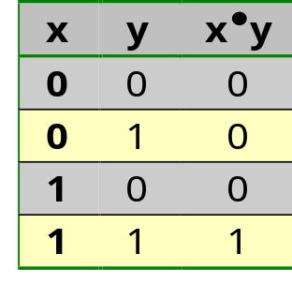
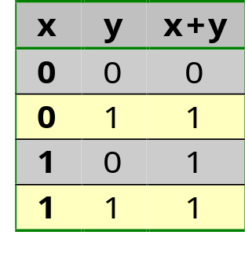
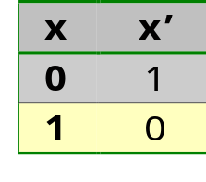
Axiomatic definition of Boolean algebra
Two-valued Boolean algebra (defined by Shannon)
AND operator
OR operator
NOT operator
1/<number>

Slide 47
Contents of “Digital Design”
Introduction to the course
Data representation
Boolean algebra
  Axiomatic definition of Boolean algebra
  Theorems of Boolean algebra
  Boolean functions
  Canonical form
  Standard form
  The 16 functions of 2 variables
Logical gates
1/<number>

Slide 48
Theorems of Boolean algebra
Theorem 1: idempotency
  x + x = x
  x • x = x (Note the duality!!)
Theorem 2
  x + 1 = 1
  Dual: x • 0 = 0
Theorem 3: absorption
  y • x + x = x (priority: • before +)
  Dual: (y + x) • x = x
Theorem 4: involution
  (x’)’ = x
1/<number>

Slide 49
Theorems of Boolean algebra
Theorem 5: associativity
  (x + y) + z = x + (y + z)
  Dual: (xy)z = x(yz)
Theorem 6: De Morgan’s law
  (x+y)’ = x’y’
  Dual: (xy)’ = x’+y’
Proof: using axioms or truth table
Duality:
  Replace each OR by AND and AND by OR
  Replace each 0 by 1 and x by x’
1/<number>

Slide 50
Contents of “Digital Design”
Introduction to the course
Data representation
Boolean algebra
  Axiomatic definition of Boolean algebra
  Theorems of Boolean algebra
  Boolean functions
  Canonical form
  Standard form
  The 16 functions of 2 variables
Logical gates
1/<number>

Slide 51
Boolean functions
What: expression in binary variables and the operators AND, OR, NOT
Priority:
  parenthesis
  NOT
  AND
  OR
Eg. F₁=xy+xy’z+x’yz
  F₁=1 when x=1 and y=1 or when x=1, y=0 and z=1 or when x=0, y=1 and z=1; in all other cases F₁=0
  F₁ consists of 3 AND-terms and 1 OR-term
1/<number>

Slide 52
Boolean functions
Realisation of F₁=xy+xy’z+x’yz
x
y
z
F₁
1/<number>

Slide 53
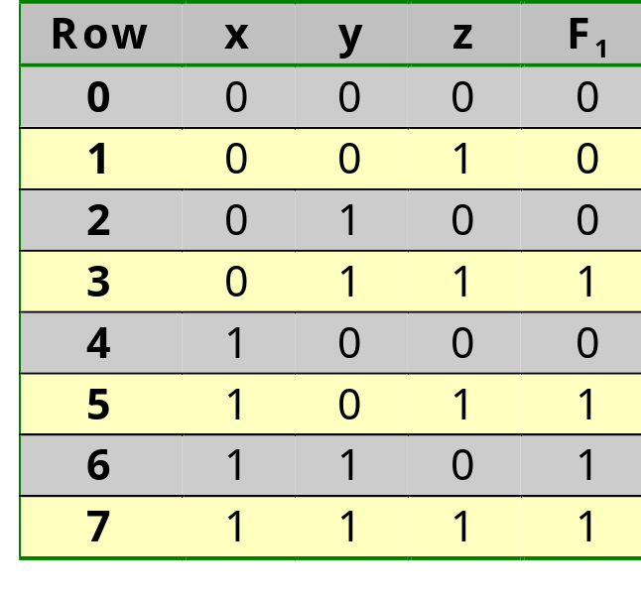
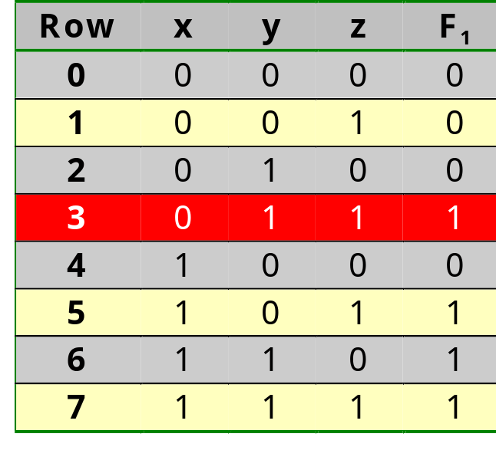
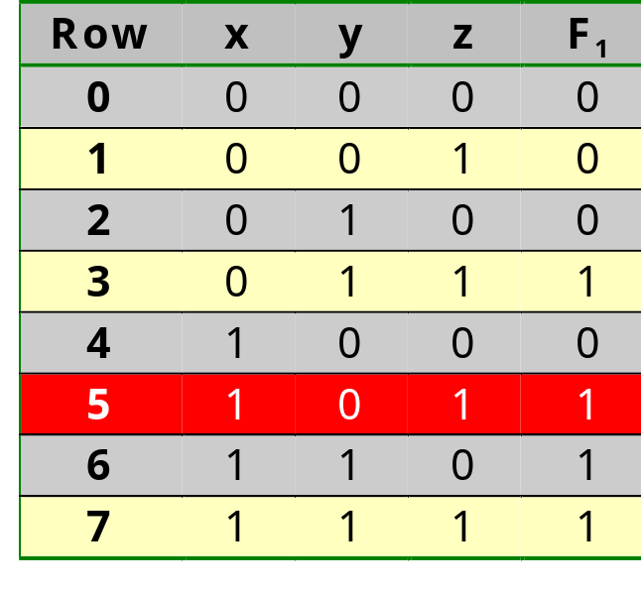
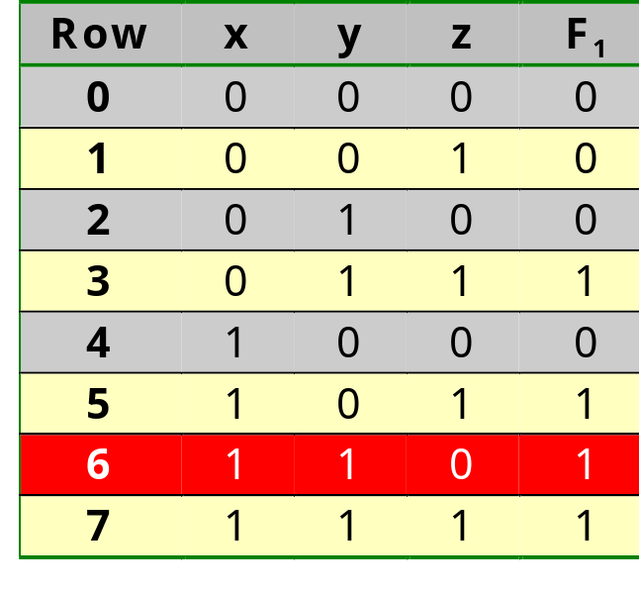
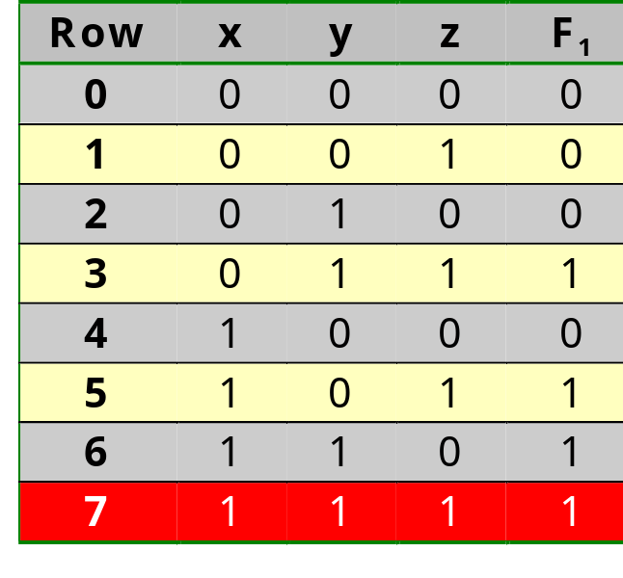
Boolean functions
Truth table for F₁=xy+xy’z+x’yz
  n variables ⇒ 2^{n} rows
  standard numbering
x
x
x
x
x
y
y
y
y
y
z
z
z
z
z
F₁
F₁
F₁
F₁
F₁
1/<number>

Slide 54
Boolean functions
Building up a truth table using standard numbering:
X
Y
Z
0
0
0
0
0
1
0
1
0
0
1
1
1
0
0
1
0
1
1
1
0
1
1
1
1/<number>

Slide 55
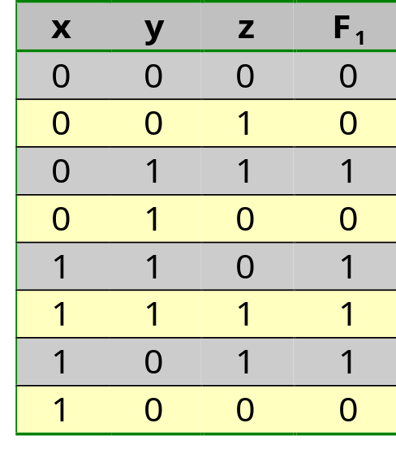
Boolean functions
Truth table for F₁=xy+xy’z+x’yz
  numbering following the Gray code (two consecutive rows only differ in 1 variable)
1/<number>

Slide 56
Boolean functions
Building up a truth table using the Gray code:
X
Y
Z
0
0
0
0
0
1
0
1
1
0
1
0
1
1
0
1
1
1
1
0
1
1
0
0
1/<number>

Slide 57
Boolean functions
Complement of a Boolean function
  F₁’ =(xy+xy’z+x’yz)’
  =(xy)’(xy’z)’(x’yz)’ (De Morgan)
  =(x’+y’)(x’+y+z’)(x+y’+z’) (De Morgan)
    This gives us the opportunity to convert an AND-OR implementation in an OR-AND implementation (see next slide)
1/<number>

Slide 58
Boolean functions
Realisation as AND-OR: F₁=xy+xy’z+x’yz
Realisation as OR-AND: F₁=((x’+y’) (x’+y+z’) (x+y’+z’))’
x
y
z
x
y
z
F₁
F₁
1/<number>

Slide 59
Boolean functions
Algebraic manipulation
  F₁ =xy+xy’z+x’yz =xy+xyz+xy’z+x’yz (absorption)
  =xy+x(y+y’)z+x’yz (distributive)
  =xy+x1z+x’yz (complement)
  =xy+xz+x’yz (identity)
  =xy+xyz+xz+x’yz (absorption)
  =xy+xz+(x+x’)yz (distributive)
  =xy+xz+1yz (complement)
  =xy+xz+yz (identity)
  This alternative form is cheaper (see next slide)
  There does not exist a fixed rule to combine theorems to guarantee a cheaper result
  Further slides will present a non-algebraic method that always leads to the cheapest solution
1/<number>

Slide 60
Boolean functions
F₁=xy+xy’z+x’yz
F₁=xy+xz+yz
x
y
z
x
y
z
F₁
F₁
1/<number>

Slide 61
Contents of “Digital Design”
Introduction to the course
Data representation
Boolean algebra
  Axiomatic definition of Boolean algebra
  Theorems of Boolean algebra
  Boolean functions
  Canonical form
  Standard form
  The 16 functions of 2 variables
Logical gates
1/<number>

Slide 62
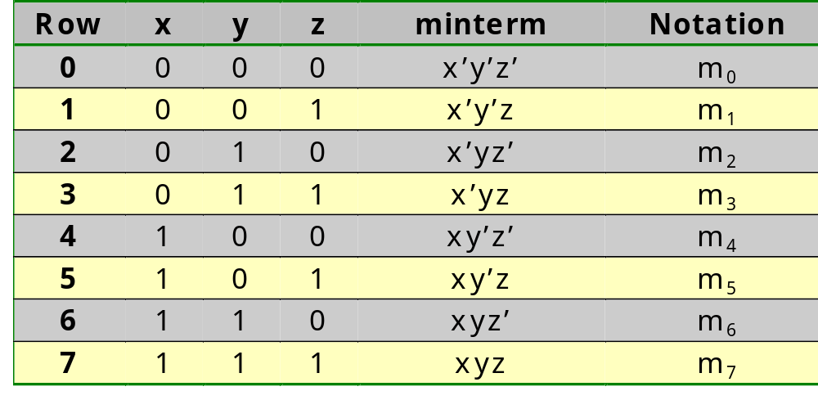
Canonical form
How do we translate a truth table into a Boolean expression?
Definition: a minterm is a Boolean function that is true in 1 row of the truth table and false elsewhere
1/<number>

Slide 63
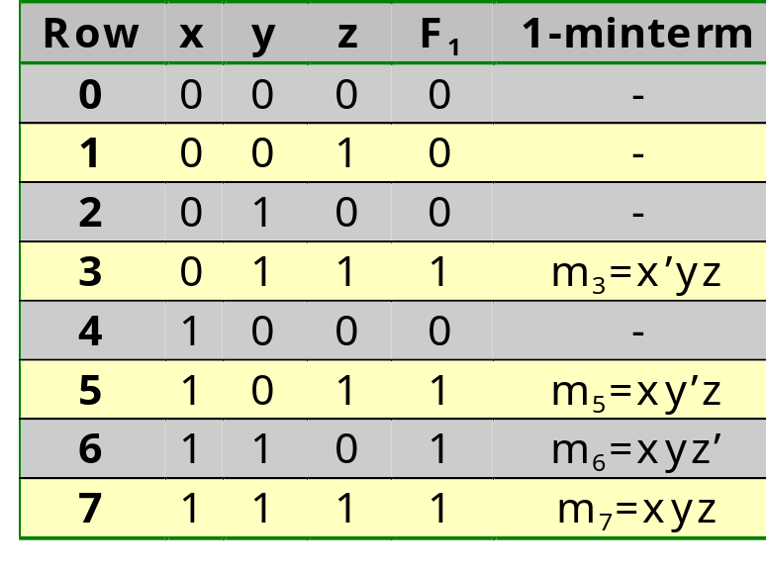
Canonical form
A 1-minterm is a minterm for which the function equals 1; a 0-minterm is a minterm for which the function equals 0
For F₁=xy+xy’z+x’yz
Each Boolean function can be expressed as the sum of its 1-minterms : F₁=x’yz+xy’z+xyz’+xyz=m₃+m₅+m₆+m₇=Σ(3,5,6,7)
1/<number>

Slide 64
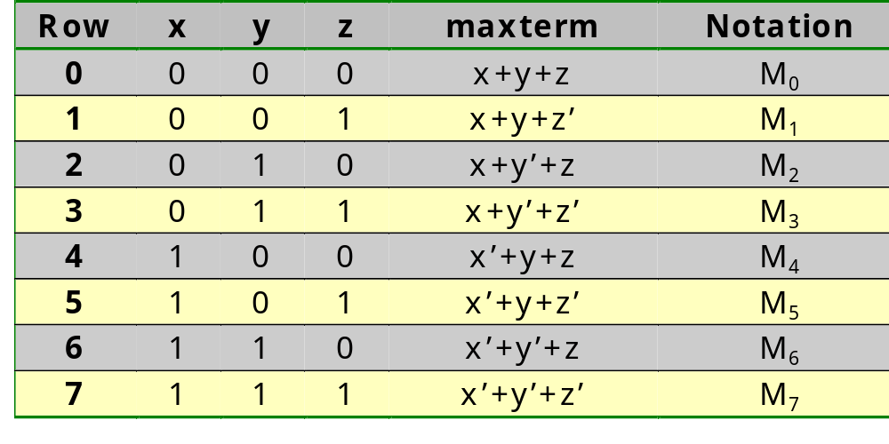
Canonical form
Dual definition: a maxterm is a Boolean function that is false in 1 row of the truth table and true elsewhere
1/<number>

Slide 65
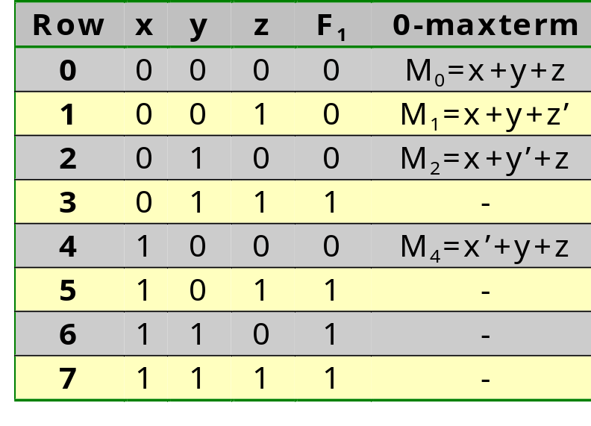
Canonical form
A 0-maxterm is a maxterm for which the function equals 0; a 1-maxterm is a maxterm for which the function equals 1
For F₁=xy+xy’z+x’yz
Each Boolean function can be expressed as the product of its 0-maxterms:
F₁ =(x+y+z)(x+y+z’)(x+y’+z)(x’+y+z)
=M₀M₁M₂M₄=Π(0,1,2,4)
1/<number>

Slide 66
Contents of “Digital Design”
Introduction to the course
Data representation
Boolean algebra
  Axiomatic definition of Boolean algebra
  Theorems of Boolean algebra
  Boolean functions
  Canonical form
  Standard form
  The 16 functions of 2 variables
Logical gates
1/<number>

Slide 67
Standard form -- minimal implementation in two layers
In the canonical form each function is a sum of 1-minterms or a product of 0-maxterms
Each minterm or maxterm contains all variables => expensive implementation
The standard form is a sum of product terms or a product of sum terms with the smallest number of variables
A product term or sum term does not necessarily contain all variables => cheaper implementation
1/<number>

Slide 68
Standard form -- minimal implementation in two layers
Example 1
  F₂ =xyz+xyz’+xy’z+xy’z’
  =xy(z+z’)+xy’(z+z’)
  =xy+xy’
  =x(y+y’)
  =x
Example 2
  F₃ =xyz+xyz’+xy’z+x’yz+x’y’z’
  =xyz+xyz’+xyz+xy’z+xyz+x’yz+x’y’z’
  =xy(z+z’)+x(y+y’)z+(x+x’)yz+x’y’z’
  =xy+xz+yz+x’y’z’
1/<number>

Slide 69
Standard form -- minimal implementation in two layers
The standard form is the cheapest implementation in two layers
Eg. F₂=xy+xz+yz
A non-standard form in more than two layers may be cheaper
Eg. F₂=x(y+z)+yz
x
y
z
x
y
z
F₂
F₂
Multiplier: O(e^{n})
Multiplier: O(n²)
1/<number>

Slide 70
Contents of “Digital Design”
Introduction to the course
Data representation
Boolean algebra
  Axiomatic definition of Boolean algebra
  Theorems of Boolean algebra
  Boolean functions
  Canonical form
  Standard form
  The 16 functions of 2 variables
Logical gates
1/<number>

Slide 71
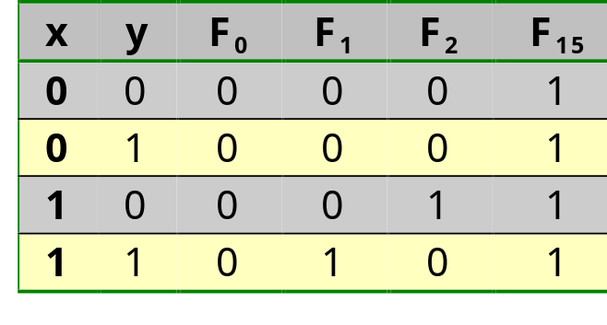
The 16 functions of 2 variables
Why 16 functions?
There exist 4 possible combinations for x and y and each combination can have a different functional value. Each function F(x,y) is hence characterized by 4 bits, i.e. the 4 functional values for xy, xy’, x’y and x’y’. With 4 bits 2⁴th different patterns for truth table are possible. Hence, there are 2⁴=16 different functions F(x,y) possible, i.e. all possible combinations of 4 bits.
1/<number>

Slide 72
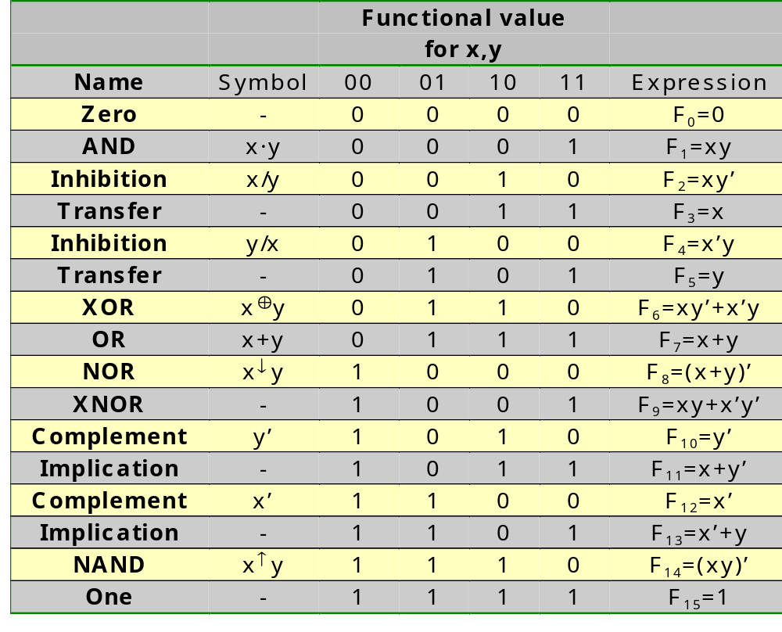
The 16 functions of 2 variables
1/<number>

Slide 73
Contents of “Digital Design”
Introduction to the course
Data representation
Boolean algebra
Logical gates
  Gates
  Non-functional properties
  Implementation technologies
1/<number>

Slide 74
Contents of “Digital Design”
Introduction to the course
Data representation
Boolean algebra
Logical gates
  Gates
    Switching transistor
    Basic logical gates
    Gates with multiple inputs (fan-in)
    Multiple operators in a single gate
  Non-functional properties
  Implementation technologies
1/<number>

Slide 75
Contents of “Digital Design”
Introduction to the course
Data representation
Boolean algebra
Logical gates
  Gates
    Switching transistor
    Basic logical gates
    Gates with multiple inputs (fan-in)
    Multiple operators in a single gate
  Non-functional properties
  Implementation technologies
1/<number>

Slide 76
Switching transistor
n-MOS transistor
Isolator
Metal
Source
Gate
Drain
n+
n+
p
1/<number>

Slide 77
Switching transistor
n-MOS transistor
Infinite number
of free electrons
Vss
Vss
Vss
Many free
electrons
Many free
electrons
n+
n+
p
D=Vss
Hardly any
free electrons:
no conducting path
between Source
and Drain
G=Vss
S=Vss
1/<number>

Slide 78
Switching transistor
n-MOS transistor
Vss
Vss
Vss
Vcc
n+
n+
p
D=Vss
Many free electrons
attracted by positive
gate voltage:
conducting channel
between Source
and Drain
G=Vcc
S=Vss
1/<number>

Slide 79
Switching transistor
p-MOS transistor
Similar construction, but ‘p’ and ‘n’ doping reversed
Conducts when
gate voltage = Vss
Does not conduct when
gate voltage = Vcc
D=Vss
D=Vss
G=Vss
G=Vcc
S=Vss
S=Vss
1/<number>

Slide 80
Contents of “Digital Design”
Introduction to the course
Data representation
Boolean algebra
Logical gates
  Gates
    Switching transistor
    Basic logical gates
    Gates with multiple inputs (fan-in)
    Multiple operators in a single gate
  Non-functional properties
  Implementation technologies
1/<number>

Slide 81
Basic logical gates
Invertor
  F=x’, 2 transistors, relative propagation delay: 1
V_{cc}
V_{cc}
V_{cc}
V_{cc}
x=0
x
x
F=1
F
F
x=0
x
x
F=1
F
x=1
F=0
x=1
F
F=0
V_{ss}
V_{ss}
V_{ss}
V_{ss}
1/<number>

Slide 82
Basic logical gates
Driver
  F=x, 4 transistors, relative propagation-delay: 2; goal: higher power drive
V_{cc}
V_{cc}
V_{cc}
V_{cc}
V_{cc}
V_{cc}
V_{cc}
V_{cc}
x=0
F=0
x=0
F=0
x=1
x
x
F=1
F
F
x=1
x
x
F=1
F
F
V_{ss}
V_{ss}
V_{ss}
V_{ss}
V_{ss}
V_{ss}
V_{ss}
V_{ss}
1/<number>

Slide 83
Basic logical gates
NAND
  F=(xy)’, 4 TOR, relative propagation-delay: 1.4
V_{cc}
V_{cc}
V_{cc}
V_{cc}
V_{cc}
V_{cc}
x=0
x=0
x=1
x=1
x
x
y=1
y=0
y=0
y=1
y
y
F=1
F=1
F=1
F=0
F
F
x=0
x=0
x=1
x=1
x
x
y=1
y=0
y=0
y=1
y
F=1
y
F=1
F=1
F=0
F
F
y=1
x=0
y=0
y=0
y=1
y
y
x=0
x=1
x=1
x
x
V_{ss}
V_{ss}
V_{ss}
V_{ss}
V_{ss}
V_{ss}
1/<number>

Slide 84
Basic logical gates
NOR
  F=(x+y)’, 4 TOR, relative propagation-delay: 1.4
V_{cc}
V_{cc}
V_{cc}
V_{cc}
V_{cc}
V_{cc}
y=0
y
y
y=1
y=0
y=1
x=0
x=0
x=1
x=1
x
x
F=1
F=0
F=0
F=0
F
F
x
x
x=0
x=0
x=1
x=1
F=1
F=0
F=0
F=0
F
F
x=0
x
x
y=0
y
x=0
y
x=1
x=1
y=1
y=0
y=1
y
y
y=0
y=1
y=0
y=1
V_{ss}
V_{ss}
V_{ss}
V_{ss}
V_{ss}
V_{ss}
1/<number>

Slide 85
Basic logical gates
AND
  F=xy, 6 TOR, relative propagation-delay: 2.4
V_{cc}
V_{cc}
x
y
F
x
y
F
y
x
V_{ss}
V_{ss}
1/<number>

Slide 86
Basic logical gates
OR
  F=x+y, 6 TOR, relative propagation-delay: 2.4
V_{cc}
V_{cc}
y
x
F
x
F
x
y
y
V_{ss}
V_{ss}
1/<number>

Slide 87
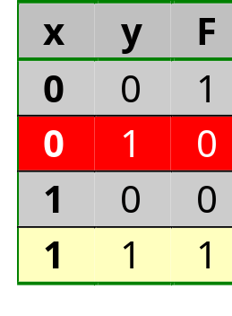
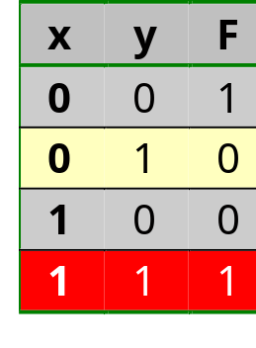
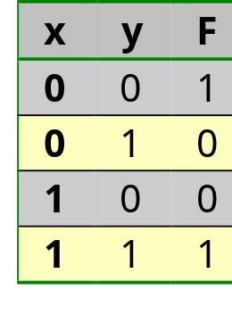
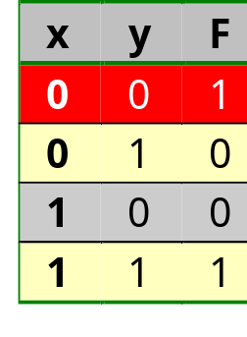
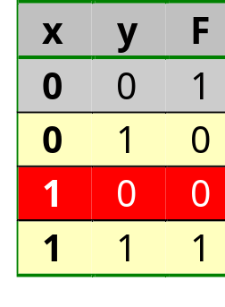
Basic logical gates
XNOR
  F=(x⊕y)’, 12 TOR,
  relative
  propagation-
  delay: 3.2
V_{cc}
V_{cc}
V_{cc}
V_{cc}
V_{cc}
V_{cc}
y=0
y=1
y=0
y=1
y
y
y’=1
y’=0
y’=1
y’=0
y’
y’
V_{cc}
V_{cc}
V_{cc}
V_{cc}
V_{cc}
V_{cc}
x=0
x=0
x=1
x=1
x
x
x’=1
x’=1
x’=0
x’=0
x’
x’
x’
x’
x’=1
x’=1
x’=0
x
x’=0
x
x
x
x
x
x
x
x=0
x=0
x=1
x=1
F=1
F=0
F=0
F=1
F
F
F=1
F=0
F=0
F=1
F
F
V_{ss}
V_{ss}
V_{ss}
V_{ss}
V_{ss}
V_{ss}
y
y
y=0
y=1
y=0
y=1
x=0
x=0
x=1
x=1
x
x
y=0
y=1
y=0
y=1
y
y
V_{cc}
V_{cc}
V_{cc}
V_{cc}
V_{cc}
V_{cc}
y’
y’
y’=0
y’=1
y’=1
y
y’=0
y
y
y
y
y
x’=1
x’=1
x’=0
x’=0
x’
x’
y’=1
y’=0
y’=1
y’=0
y’
y’
V_{ss}
V_{ss}
V_{ss}
V_{ss}
V_{ss}
V_{ss}
V_{ss}
V_{ss}
V_{ss}
V_{ss}
V_{ss}
V_{ss}
1/<number>

Slide 88
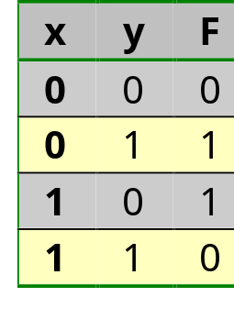
Basic logical gates
XOR
  F=(x⊕y), 12 TOR,
  relative
  propagation-
  delay: 3.2
V_{cc}
y’
y
V_{cc}
x
x’
x
x’
x
F
F
V_{ss}
y
x
y’
V_{cc}
y
y’
x’
y
V_{ss}
V_{ss}
1/<number>

Slide 89
Contents of “Digital Design”
Introduction to the course
Data representation
Boolean algebra
Logical gates
  Gates
    Switching transistor
    Basic logical gates
    Gates with multiple inputs (fan-in)
    Multiple operators in a single gate
  Non-functional properties
  Implementation technologies
1/<number>

Slide 90
Gates with multiple inputs (fan-in)
3-input NAND
  F=(xyz)’, 6 TOR,
  relative
  propagation-
  delay: 1.8
V_{cc}
x
y
z
z
F
F
y
x
y
z
x
V_{ss}
1/<number>

Slide 91
Contents of “Digital Design”
Introduction to the course
Data representation
Boolean algebra
Logical gates
  Gates
    Switching transistor
    Basic logical gates
    Gates with multiple inputs (fan-in)
    Multiple operators in a single gate
  Non-functional properties
  Implementation technologies
1/<number>

Slide 92
Multiple operators in a single gate
2-wide 2-input
AND-OR-Invert
  F=(xy + zw)’, 8 TOR,
  relative
  propagation-
  delay: 2.2
V_{cc}
z
w
x
y
x
y
F
F
z
y
w
w
x
z
V_{ss}
1/<number>

Slide 93
Multiple operators in a single gate
2-wide 2-input
OR-AND-Invert
  F=((x+y)(z+w))’,
  8 TOR,
  relative
  propagation-
  delay: 2.2
V_{cc}
y
w
x
z
F
x
z
w
y
F
z
w
x
y
V_{ss}
1/<number>

Slide 94
Contents of “Digital Design”
Introduction to the course
Data representation
Boolean algebra
Logical gates
  Gates
  Non-functional properties
    Logical voltage levels and noise margin
    Fan-out
    Power dissipation
    Propagation delay
  Implementation technologies
1/<number>

Slide 95
Contents of “Digital Design”
Introduction to the course
Data representation
Boolean algebra
Logical gates
  Gates
  Non-functional properties
    Logical voltage levels and noise margin
    Fan-out
    Power dissipation
    Propagation delay
  Implementation technologies
1/<number>

Slide 96
Logic voltage levels and noise margin
For CMOS and TTL, 0V corresponds to the logical ‘0’ and 5V to ‘1’ (ideal and in steady state)
Realistically and during transition for TTL invertor:
V_{out}
5
Variation function of:
- temperature
- power supply voltage
- manufacturing
High
2.4
0.4
Low
0
V_{in}
0
0.8
2.0
5
Low
High
1/<number>

Slide 97
Logic voltage levels and noise margin
TTL guarantees a low output level between 0V and 0.4V (=V_{OL}) and recognizes voltages between 0V and 0.8V (=V_{IL}) as logic ‘0’
Noise up to 0.4V peak between output and next input are interpreted correctly
The noise margin is hence V_{IL}-V_{OL}=0.4V
TTL guarantees a high output level between 2.4V (=V_{OH}) and 5V and recognizes voltages between 2.0V (=V_{IH}) and 5V as logic ‘1’
Noise up to 0.4V peak between output and next input are interpreted correctly
The noise margin is hence V_{OH}-V_{IH}=0.4V
1/<number>

Slide 98
Logic voltage levels and noise margin
Graphical representation of noise margin:
V_{cc}
V_{cc}
High
High
V_{OH}
Margin
V_{IH}
V_{IL}
V_{OL}
Margin
Low
Low
V_{ss}
V_{ss}
Output
Input
1/<number>

Slide 99
Contents of “Digital Design”
Introduction to the course
Data representation
Boolean algebra
Logical gates
  Gates
  Non-functional properties
    Logical voltage levels and noise margin
    Fan-out
    Power dissipation
    Propagation delay
  Implementation technologies
1/<number>

Slide 100
Fan-out: ‘current driven’ technologies cf. TTL, ECL, ...
Fan-out: maximum number of inputs that may be connected to a single output
Depends on the current that may be delivered by the driving gate (source) (I_{OH}) w.r.t. the current consumed by the driven gate (I_{IH}) and on the current sinked by the driving gate (sink) (I_{OL}) w.r.t. the current delivered by the driven gate (I_{IL})
Fan-out = min(I_{OH}/I_{IH},I_{OL}/I_{IL})
I_{IH}
I_{IL}
I_{OH}
I_{OL}
1/<number>

Slide 101
Fan-out: ‘charge driven’ technologies cf. CMOS
Fan-out: maximum number of inputs that may be connected to a single output
Depends on the current that may be sourced resp. sinked by the driving gate (I_{OH} resp. I_{OL}) w.r.t. the capacity of the connected inputs and the connecting wire and to the switching time allowed
I=dQ/dt=C.dV/dt=C.f.ΔV => determines maximum switching frequency
e.g. based on realistic values for Xilinx Virtex:
  10 pF input capacity, 20 mA drive current, 0.8 pF/cm PCB connect, V_{cc}=3.3 V
  For fan-out=3 and 10 cm PCB connect: C=3*10+0.8*10=38 pF and switching frequency = I/(C.ΔV)=20 mA/(38 pF * 3.3 V)=160 MHz
1/<number>

Slide 102
Contents of “Digital Design”
Introduction to the course
Data representation
Boolean algebra
Logical gates
  Gates
  Non-functional properties
    Logical voltage levels and noise margin
    Fan-out
    Power dissipation
    Propagation delay
  Implementation technologies
1/<number>

Slide 103
Power dissipation
TTL dissipates continuously
  P=V_{CC}*I_{CC}≈10mW/gate
  1 million gates: 10 KW!!
  Only used when high voltages or large currents are needed (busdrivers, …)
CMOS dissipates only while switching
  P=C.f.V² since I=C.f.V
    C: proportional to chip area (trend: increase)
    f: trend: steep increase: 1MHz → 1 GHz
    V: trend: steady decrease: 5 → 3.3 → 2.5 → 1.8 → 1.5 → 1.2 → 0.9
    Virtex example: P=38 pF*160 MHz*(3.3 V)²=
    66 mW per switching pin; assuming 200 pins, half of which switch concurrently, gives 6.6 W for driving the external pins
  Advanced microprocessors: 40W ⇒ Cooling!!!
  Is currently the limiting design factor
1/<number>

Slide 104
Contents of “Digital Design”
Introduction to the course
Data representation
Boolean algebra
Logical gates
  Gates
  Non-functional properties
    Logical voltage levels and noise margin
    Fan-out
    Power dissipation
    Propagation delay
  Implementation technologies
1/<number>

Slide 105
Propagation delay
Rise
time
Fall
time
Rise time > Fall time
90%
50%
10%
90%
50%
10%
Propagation delay:
t_{P}=(t_{PLH}+t_{PHL})/2
t_{PLH}
t_{PHL}
1/<number>

Slide 106
Contents of “Digital Design”
Introduction to the course
Data representation
Boolean algebra
Logical gates
  Gates
  Non-functional properties
  Implementation technologies
    SSI, MSI, LSI, VLSI
    Custom design, standard cell design
    Gate array
    PLA, PLD, FPGA
1/<number>

Slide 107
Contents of “Digital Design”
Introduction to the course
Data representation
Boolean algebra
Logical gates
  Gates
  Non-functional properties
  Implementation technologies
    SSI, MSI, LSI, VLSI
    Custom design, standard cell design
    Gate array
    PLA, PLD, FPGA
1/<number>

Slide 108
SSI, MSI, LSI, VLSI (I)
SSI: Small Scale Integration
  < 10 gates per package
  gates directly connected to package pins
  designed using transistor level design
  used using gate level design
MSI: Medium Scale Integration
  10 - 100 gates per package
  registers, adders, parity generators, …
  designed using gate level design
  used using RTL design
LSI: Large Scale Integration
  100 - 10K gates per package
  controllers, data paths
  designed using RTL design
  used using behavioral level design
1/<number>

Slide 109
SSI, MSI, LSI, VLSI (II)
VLSI: Very Large Scale Integration
  10K - 1M gates per package
  memory, microprocessor, microcontroller, FFT
  designed using behavioral level design
  used using system level design
ULSI: Ultra Large Scale Integration???
  1M - ?? Gates per package
  2 μcontrollers, 20 DSP processors, 16 Mbyte memory, 10 accelerators, 1 Mgate FPGA, Analog interface, RF
  designed using system level design
  only one chip needed for complete application ??
1/<number>

Slide 110
Contents of “Digital Design”
Introduction to the course
Data representation
Boolean algebra
Logical gates
  Gates
  Non-functional properties
  Implementation technologies
    SSI, MSI, LSI, VLSI
    Custom design, standard cell design
    Gate array
    PLA, PLD, FPGA
1/<number>

Slide 111
Custom design
Each transistor and each connection is designed individually as a set of rectangles.
Excellent for optimal design of library elements that are re-used multiple times
Companies design and sell such optimized libraries
Has to be completely re-done each time technology changes (every 18 months!)
1/<number>

Slide 112
Standard cell design
Library of standard cells
  each cell is a gate
  standard height, variable width, interleaved by routing channels
  all inputs at the top, all outputs at the bottom
Faster design of more complex building blocks
Silicon foundries design and sell such optimized libraries for their processing technology
Placement and routing
1/<number>

Slide 113
Standard cell design
Design Flow
Design entry
Simulation
Placement
Routing
Timing simulation
Fabrication: n masks
Testing
1/<number>

Slide 114
Contents of “Digital Design”
Introduction to the course
Data representation
Boolean algebra
Logical gates
  Gates
  Non-functional properties
  Implementation technologies
    SSI, MSI, LSI, VLSI
    Custom design, standard cell design
    Gate array
    PLA, PLD, FPGA
1/<number>

Slide 115
Gate array design
Two-dimensional grid of identical gates
  each cell is for example a 3-input NAND gate
  standard height, standard width, interleaved by routing channels
  all inputs at the top, all outputs at the bottom
Cheaper:
  Only the last metallisation layer is project specific
1/<number>

Slide 116
Gate array design
Design Flow
Design entry
Simulation
Map all functions to
the available 3-input
NANDs
Technology mapping
Placement
Routing
Timing simulation
Fabrication: 1 mask
Testing
1/<number>

Slide 117
Contents of “Digital Design”
Introduction to the course
Data representation
Boolean algebra
Logical gates
  Gates
  Non-functional properties
  Implementation technologies
    SSI, MSI, LSI, VLSI
    Custom design, standard cell design
    Gate array
    PLA, PLD, FPGA
1/<number>

Slide 118
Field-programmable design
Fuse programmable
  One time customer programmable by selectively blowing fuses
  PLA: Programmable Logic Array
  PLD: Programmable Logic Device
  CPLD: Complex PLD
SRAM based
  FPGA: Field Programmable Gate Array (see laboratory sessions)
Properties:
  Excellent for prototypes
  Excellent for medium volumes (<100K pieces/year)
  For SRAM based: reconfiguration (static or dynamic) possible
  2 Mgates @ 200 MHz (in 2000)
1/<number>

Slide 119
Field-programmable design
PLA
1/<number>

Slide 120
Field-programmable design
PLD
D
D
1/<number>

Slide 121
Field-programmable design
CPLD
O
I/O
I/O
O
AND-OR
Plane
AND-OR
Plane
Switch matrix
AND-OR
Plane
AND-OR
Plane
O
I/O
I/O
O
1/<number>

Slide 122
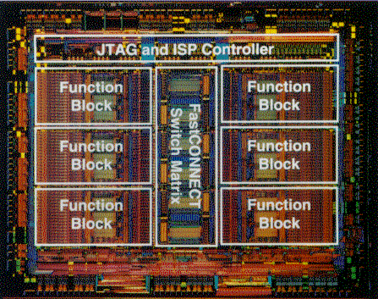
Field-programmable design
XC95216
  6 Functional blocks (36V18 each)
  Flash programmable
1/<number>

Slide 123
Field-programmable design
FPGA: XC40xx
Direct connections
Routing via switching matrices
Long lines
I/O
I/O
I/O
I/O
I/O
SM
SM
SM
SM
CLB
CLB
CLB
I/O
SM
SM
SM
SM
CLB
CLB
CLB
I/O
SM
SM
SM
SM
1/<number>

Slide 124
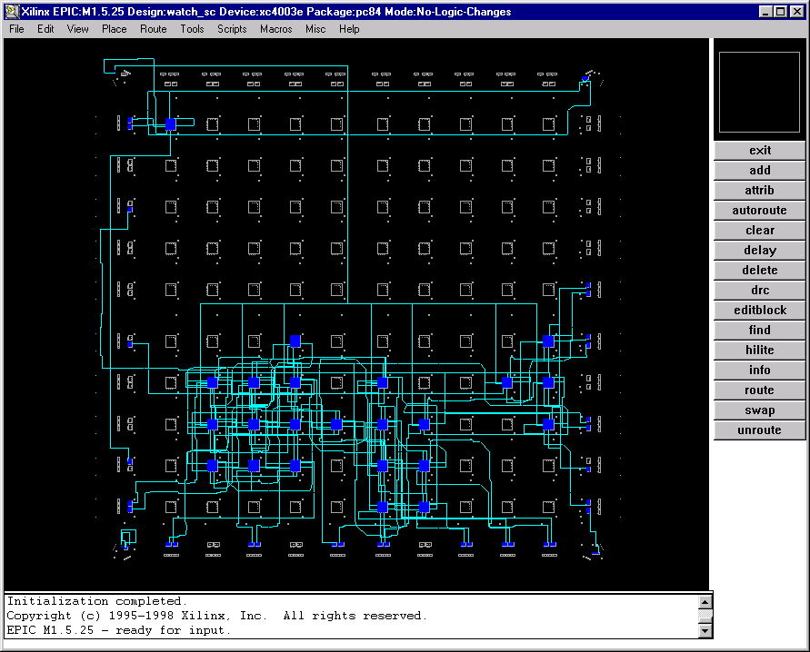
Field-programmable design
1/<number>

Slide 125
Field-programmable design
FPGA: Configurable Logic Block CLB
16x1
LUT:
Bool-function
of 4
variables
G
FF
GQ
G
16x1
LUT:
Bool-function
of 4
variables
F
FF
FQ
F
1/<number>

Slide 126
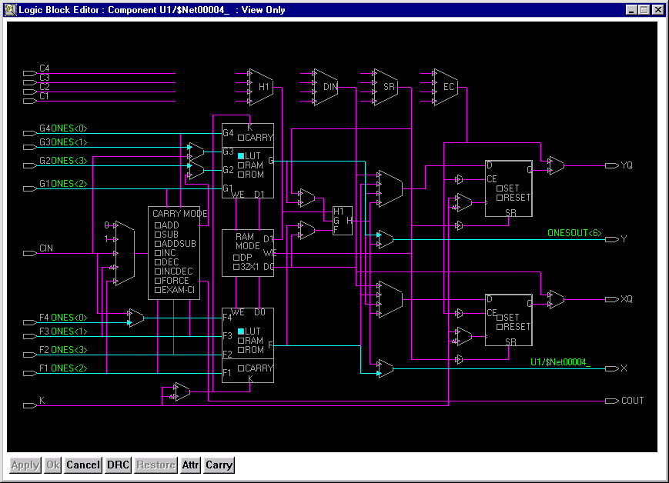
Field-programmable design
1/<number>

Slide 127
Field-programmable design
FPGA: Switching Matrix SM
Pass
TOR
1/<number>

Slide 128
Field programmable design
Design Flow
Design entry
Simulation
Technology mapping
Placement
Routing
Timing simulation
Downloading
Testing
1/<number>

